Slide 1
“Animation Fidelity in Self-Avatars: Impact on User Performance and Sense of Agency”
Haoran Yun, Jose Luis Ponton, Carlos Andujar, Nuria Pelechano
2023 IEEE Conference Virtual Reality and 3D User Interfaces (VR), Shanghai, China, 2023, pp. 286-296
IHC – Interação Humano-Computador
Guilherme Santos, 107961
João Gaspar, 107708
LECI – Licenciatura em Engenharia de Computadores e Informática
06 de março de 2024

Slide 2
Index
01 Motivation
03
Paper Analysis
05 Discussion
04 Results
02
Introduction
06 Conclusion
2

Slide 3
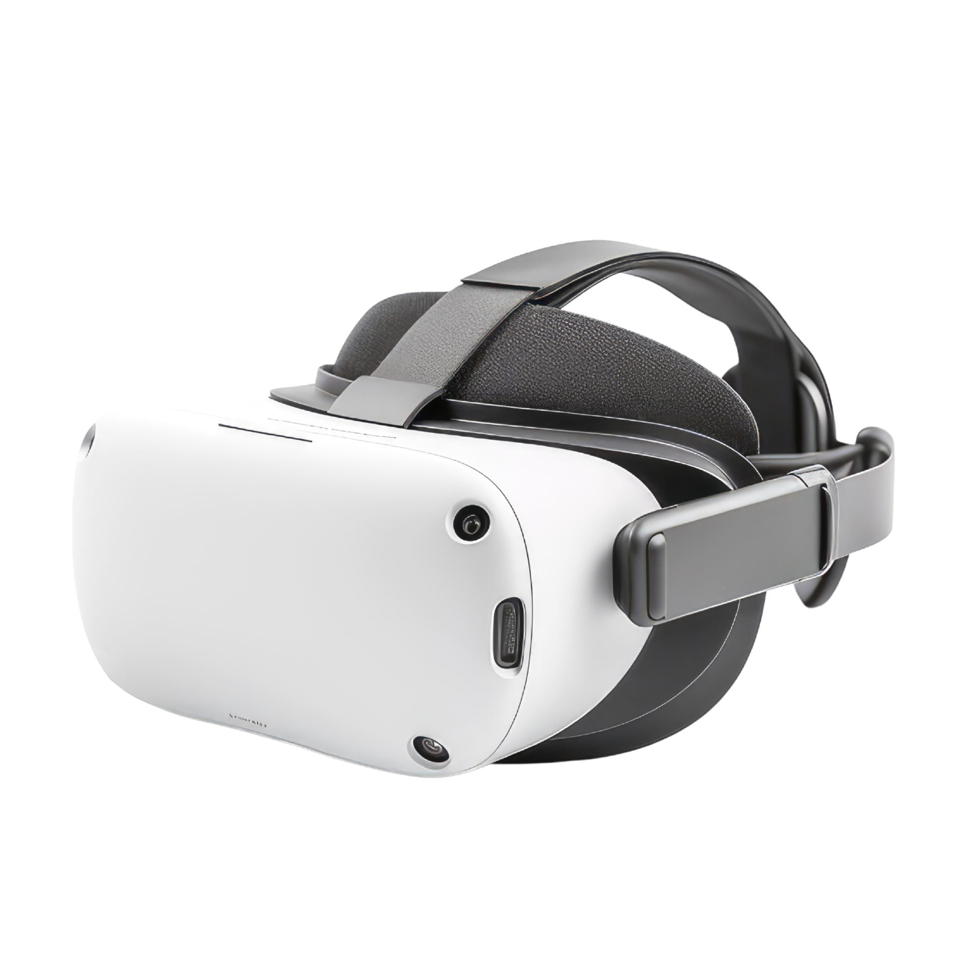
1 - Motivation
Why did we choose this paper?
Interesting subject;
Growing fast;
Important Technology.

Slide 4
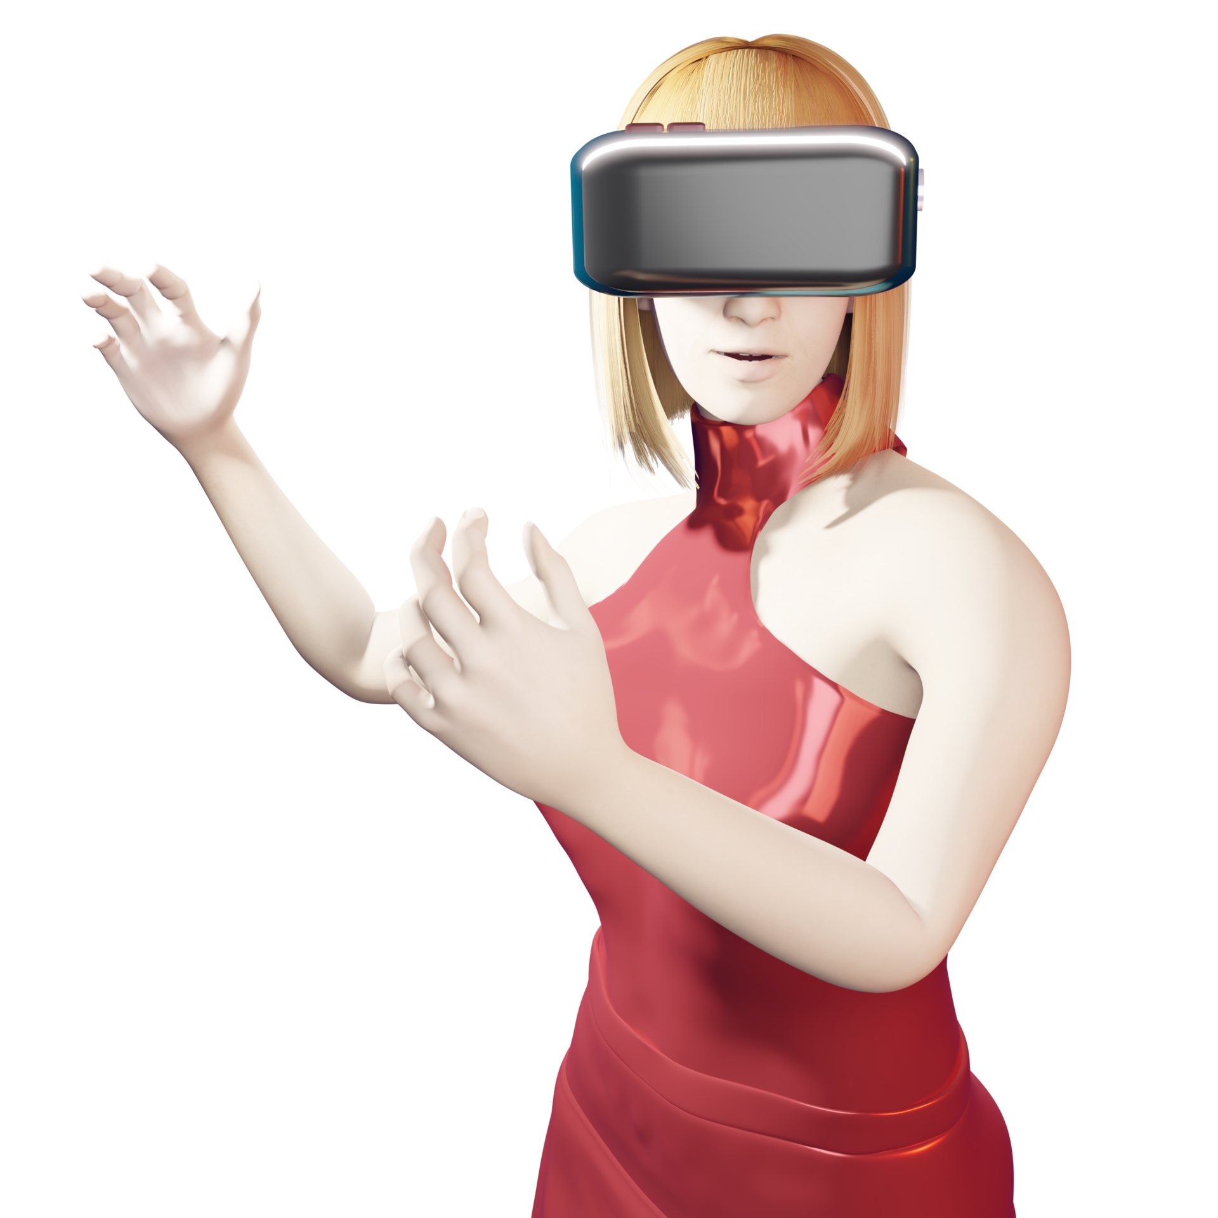
2 - Introduction
The importance of fidelity in VR avatar animation;
Challenges of animating avatars with consumer devices.

Slide 5
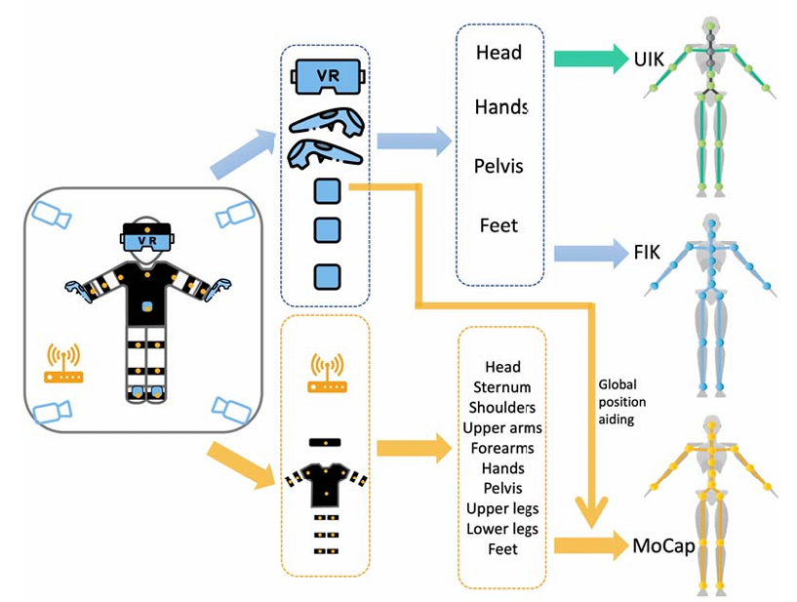
Animation fidelity conditions:
Unity Inverse Kinematics (UIK);
FinalIK (FIK);
Motion capture with Xsens (MoCap).
3 – Paper Analysis: Experimental Conditions

Slide 6
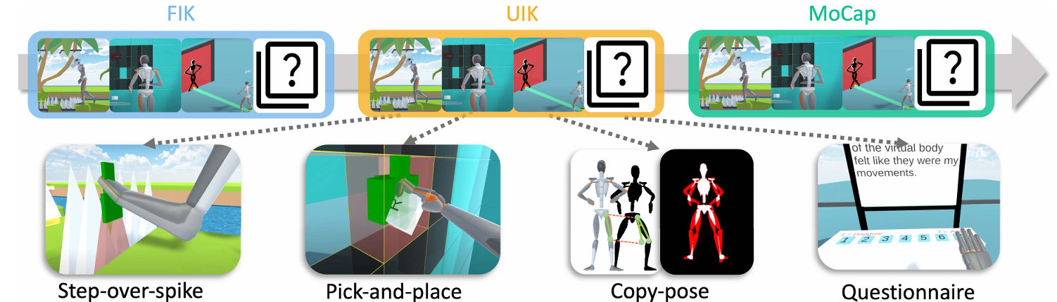
Study tasks:
Step-over-spikes;
Pick-and-place;
Copy-pose.
3 – Paper Analysis:
Tasks

Slide 7
3 – Paper Analysis:
Procedure
26 participants (22 men and 4 women), one of whom was excluded.

Slide 8
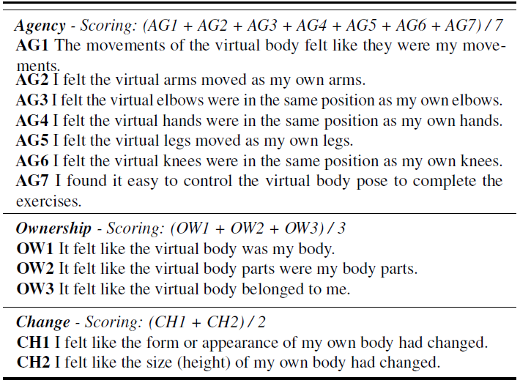
3 – Paper Analysis:
Measurements
Jaccard distance (JD);
Mean per segmente angle error;
Task Performance Metrics;
Virtual Embodiment Questionnaire.

Slide 9
H1: Animation fidelity impacts performance of the user in step-over spikes and pick-and-place (tasks that require precise interaction with the environment), in terms of unintended collisions and completion time;
H2: Animation fidelity impacts performance in copy-pose task, which requires accuracy in the body pose;
H3: Animation fidelity affects the SoE.
3 – Paper Analysis:
Hypotheses

Slide 10
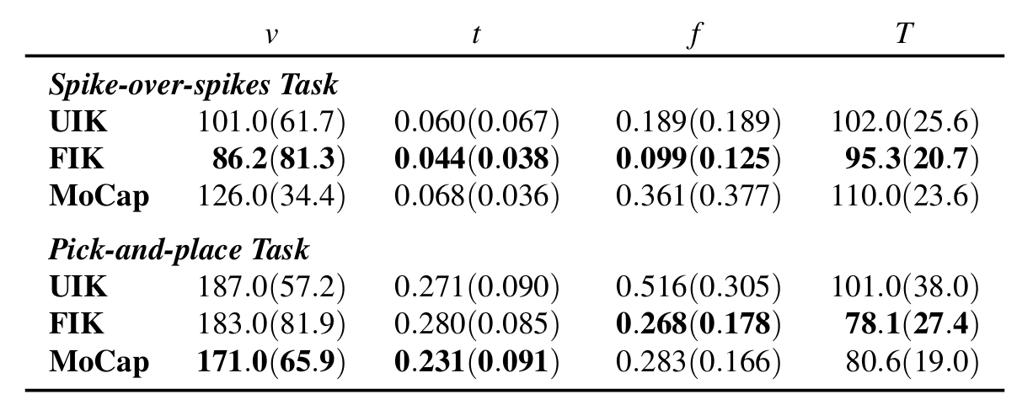
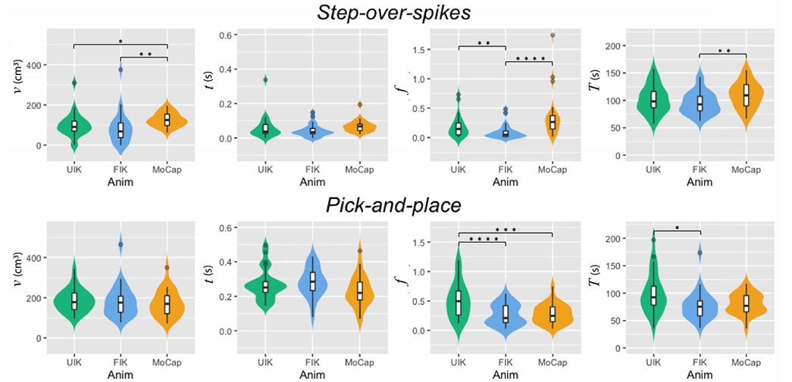
4 – Results: User performance on interaction tasks

Slide 11
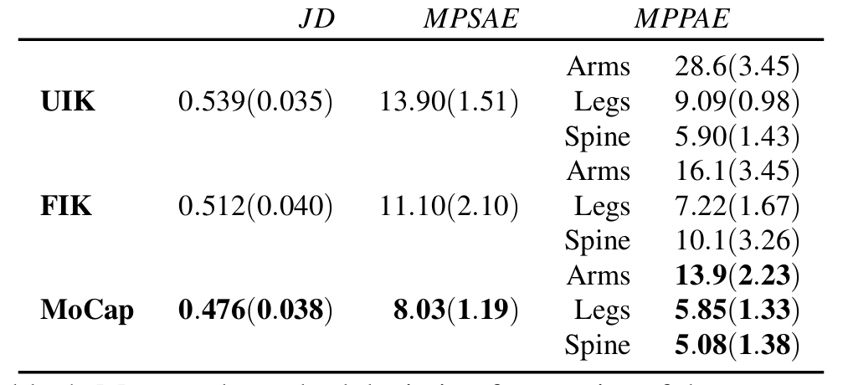
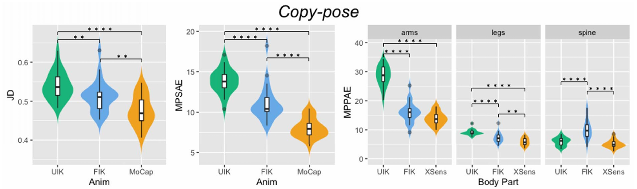
4 – Results: User performance on pose-related tasks

Slide 12
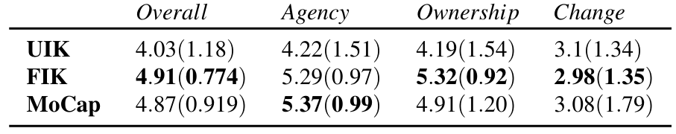
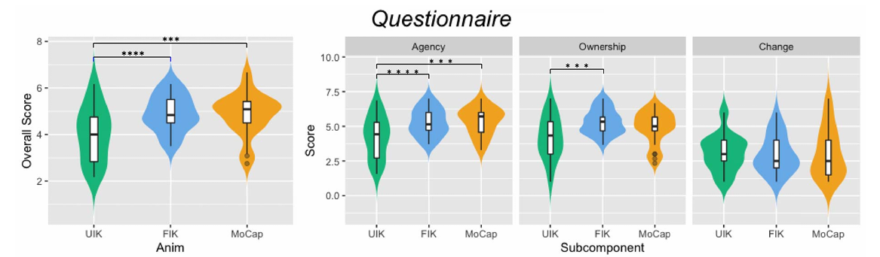
4 – Results: Questionnaire results

Slide 13
5 - Dicussion
MoCap accuracy:
Greater accuracy in representing human poses.
Performance in Dynamic Tasks:
Lower MoCap on obstacles due to positional deviation and latency.
Accurate Interactions:
MoCap and FIK outperform UIK in interaction accuracy.
13

Slide 14
5 - Dicussion
Differences between arms and legs:
Arm poses less precise than legs, noted by participants.
Recommendation for Animation:
Focus on animating the upper body.
Sense of Agency with Few Devices:
High sense of agency with smaller set of devices, MoCap does not outperform experience with simple IK.
14

Slide 15
6 - Conclusion
IMU system outperforms Inverse Kinematics (IK) solutions in pose accuracy;
Accurate end effector placement and low latency are critical in direct Virtual Environment (VE) interactions;
Limitation in accurately matching the avatar to the participant's shape, affecting the reproduction of self-references suggested by some "Copy-pose" targets in VR.
15

Slide 16
Questions?
16

Slide 17
Bibliography
H. Yun, J. L. Ponton, C. Andujar and N. Pelechano, "Animation Fidelity in Self-Avatars: Impact on User Performance and Sense of Agency," 2023 IEEE Conference Virtual Reality and 3D User Interfaces (VR), Shanghai, China, 2023, pp. 286-296, doi: 10.1109/VR55154.2023.00044.
17

